Slide 1


FDIR Spacecraft fault protection system
Project 2
OP6
Architectural Design
Euro Team
Alauzet Pierre, Ahvenniemi Mikko,
Colin Julien, Starck Benoit
CS554 - Design for Software & Systems

Slide 2
Table of Contents
Background
Architectural design
Architectural analysis
Remaining work

Slide 3
Atam steps reminder
1. Background
2. Architectural design
3. Architectural analysis
4. Remaining work
1
2
Present FDIR business drivers
3
Present FDIR architecture made through ACME
4
5
6
7
8
9
Identify FDIR architectural approaches made through ACME
Generate FDIR quality attribute utility tree
Analyze architectural FDIR approaches made through ACME
Brainstorm and prioritize scenarios of FDIR requirement
Analyze FDIR architectural approaches made through ACME
Present FDIR ATAM assessment results
Present the ATAM

Slide 4
How to design our architecture ?
1. Background
2. Architectural design
3. Architectural analysis
4. Remaining work
Starting from ATAM to take critical architectural decisions
Architecture will be based on the architectural approach (step 4)
Architecture has to respect the most important requirements (step 5)
Utility tree
Prioritized scenarios
Propose an architecture
Precise the architectural context
Choose the best architectural type to represent our system
Design the architecture through our ADL tool (ACME Studio)
Document and explain the architecture

Slide 5
How to analyze our architecture ?
1. Background
2. Architectural design
3. Architectural analysis
4. Remaining work
Compare the requirements with the architectural design
Do we meet the quality attributes goals ?
Do we satisfy the requirements as portrayed in the utility trees and scenarios
Architectural key decisions soul-searching
What are the strengths and weaknesses of our architectural design ?
If we compare the chosen architectural type with another's through our architectural design, could our architecture be better or worth ?

Slide 6
Critical architectural decisions
1. Background
2. Architectural design
3. Architectural analysis
4. Remaining work
Architectural approach
Enables asynchronous processing
High potential for resilience in case of failure
Load can be balanced efficiently between systems
Utility tree
Availability
Reliability
Recoverability
Scenarios
Use case scenarios: user action should be done at any moment
Exploratory scenario: if a FDIR sub-system is crashing, FDIR should still work

Slide 7
Architectural design proposition
1. Background
2. Architectural design
3. Architectural analysis
4. Remaining work
Architectural context
Centralized system
Distributed system
Producer
Broker
Consumer
Producer
Consumer

Slide 8
Architectural design proposition (cont.)
1. Background
2. Architectural design
3. Architectural analysis
4. Remaining work
Architectural context
Centralized system
Distributed system
Producer
Broker
Consumer
Producer
Consumer

Slide 9
Architectural design proposition (cont.)
1. Background
2. Architectural design
3. Architectural analysis
4. Remaining work
Architectural types: available families in ACME Studio are
Tiered
Pipe & filters
Client & servers
Shared data
Three-tiered
Pub-Sub

Slide 10
Architectural design proposition (cont.)
1. Background
2. Architectural design
3. Architectural analysis
4. Remaining work
Architectural types: available families in ACME Studio are
Tiered
Pipe & filters
Client & servers
Shared data
Three-tiered
Pub-Sub
Event based architecture where publishers and subscribers don’t know each others.
publishers notifies subscribers about news
subscribers are submitting their interest in particular news
This architectural style is :
space-decoupled : the event service links publishers and subscribers that don’t know each others
time-decoupled : publishers can send notifications while subscribers are not running and vice versa
synchronization-decoupled : concurrent activities can be performed by publishers and subscribers

Slide 11
Design architecture proposition (cont.)
1. Background
2. Architectural design
3. Architectural analysis
4. Remaining work
Pub-sub (Publish /Subscribes)
Content based
Subscription system based on a defined type of content
Subscribers declare the types of event they are interested to, by using filters
Possible to define combination of several types, but complex protocol
Topic based
Bundle communication peers, with methods to characterize & classify event content (divided by keys in a string shape).
Each topic is linked to an individual communication channel
Every topic is a static and primitive kind of event that a subscriber subscribes to

Slide 12
Design architecture proposition (cont.)
1. Background
2. Architectural design
3. Architectural analysis
4. Remaining work
Pub-sub (Publish /Subscribes)
Content based
Subscription system based on a defined type of content
Subscribers declare the types of event they are interested to, by using filters
Possible to define combination of several types, but complex protocol
Topic based
Bundle communication peers, with methods to characterize & classify event content (divided by keys in a string shape).
Each topic is linked to an individual communication channel
Every topic is a static and primitive kind of event that a subscriber subscribes to

Slide 13
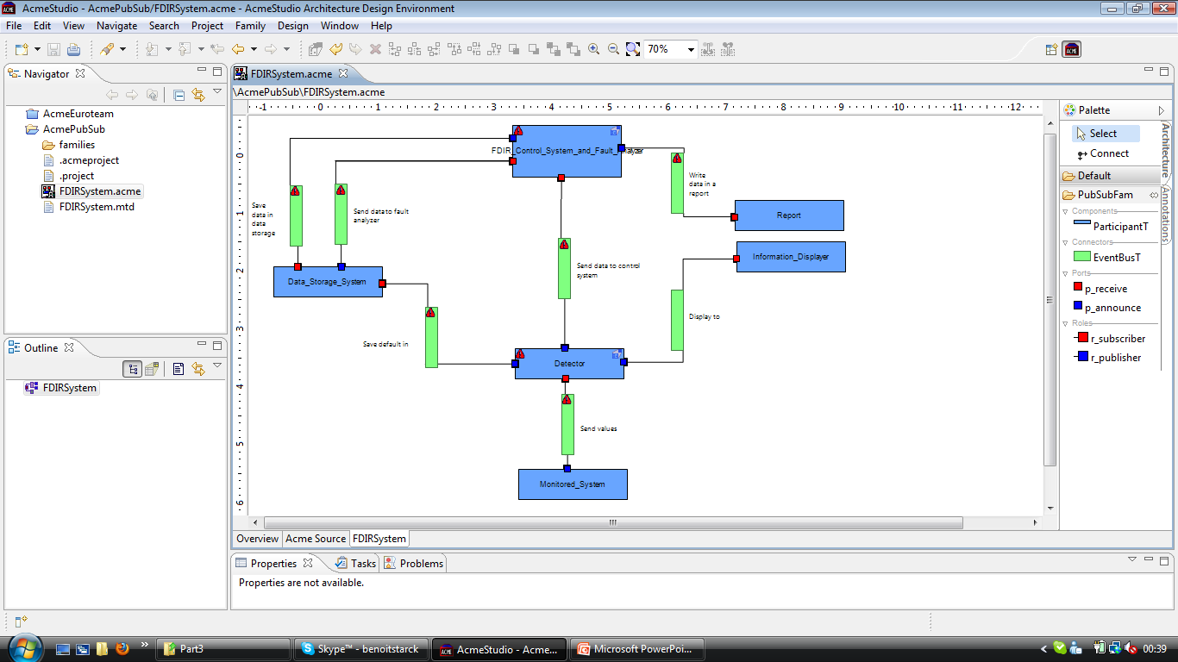
Design architecture proposition (cont.)
1. Background
2. Architectural design
3. Architectural analysis
4. Remaining work

Slide 14
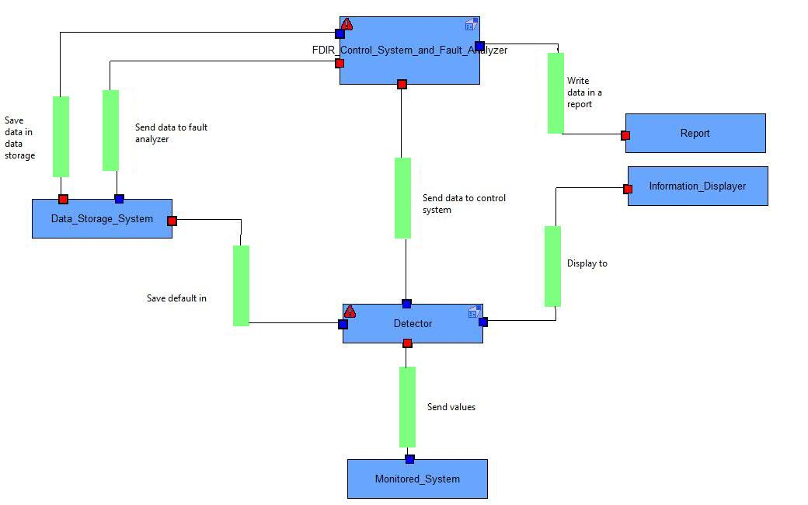
Architecture : FDIR SYSTEM representation
1. Background
2. Architectural design
3. Architectural analysis
4. Remaining work

Slide 15
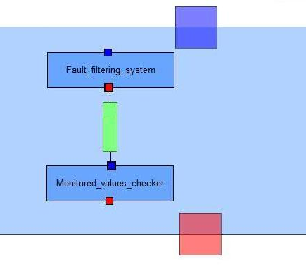
Architecture : Fault detector representation
1. Background
2. Architectural design
3. Architectural analysis
4. Remaining work

Slide 16
Architecture : FDIR SYSTEM representation
1. Background
2. Architectural design
3. Architectural analysis
4. Remaining work

Slide 17
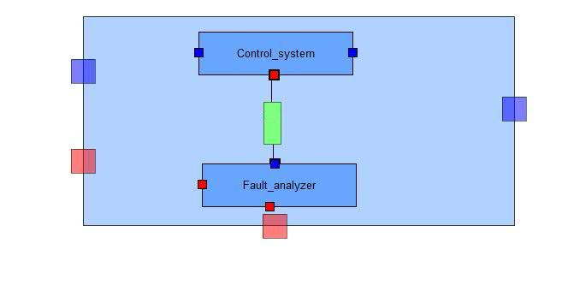
Architecture : Control system & fault analyzer
1. Background
2. Architectural design
3. Architectural analysis
4. Remaining work

Slide 18
Architecture : FDIR SYSTEM representation
1. Background
2. Architectural design
3. Architectural analysis
4. Remaining work

Slide 19
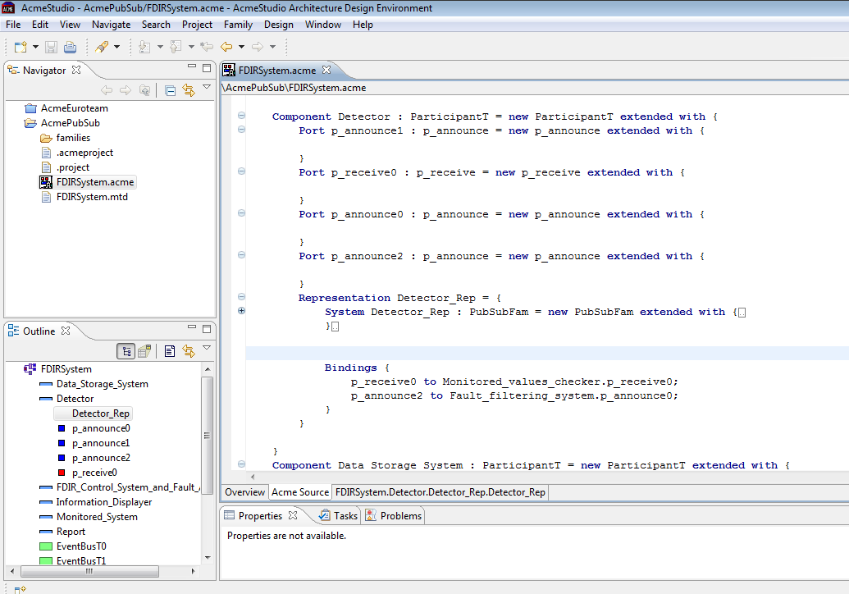
Architecture : code sample
1. Background
2. Architectural design
3. Architectural analysis
4. Remaining work

Slide 20
FDIR & ADL Requirements compliance
1. Background
2. Architectural design
3. Architectural analysis
4. Remaining work
Thanks to Publish/Subscribe pattern
FDIR is a monitoring system involving several interaction between several components
Event-based architecture
Publish/Suscribe architectural style meet the need of asynchronous communication
The topic-based aspect allows us to focus on a limited number of kind of event
Control operation
Monitored values
Analysis results
Reports
Etc.
Publish and suscribe family is ready-to-be-used within ACME Studio tool

Slide 21
FDIR & ADL Requirements compliance (cont.)
1. Background
2. Architectural design
3. Architectural analysis
4. Remaining work
FDIR system organization
The layered fault analyzer and control system are better defined using a waterfall of publishers/subscribers
ACME studio allows us to clearly divide our architecture as we did with the overall model using representations
Utility tree
Availability & reliability are reached thanks to the loosed-coupling components in publish/subscribe architectural style
Recoverability is respected thanks to the independence of entities (publishers & subscribers) that can recover from failure while FDIR global system is still working

Slide 22
Architectural design strenghs
1. Background
2. Architectural design
3. Architectural analysis
4. Remaining work
Loosely coupled
Publishers and Subscribers need not know of each other’s existence
They can also ignore system topology
Decoupling doesn’t work only location wise, but also temporally
Taking publishers down allows subscriber work through backlog for example
Scalable
Provides better scalability then client-server architecture in smaller installations
Parallel operation, message caching, tree-based or network-based routing

Slide 23
Architectural design weaknesses
1. Background
2. Architectural design
3. Architectural analysis
4. Remaining work
Disadvantages also stem from decoupling of publishers from subscribers
Stronger guarantees cannot be given that messages would always be delivered
Another problem can arise if publishers assume that subscribers are listening. For example if error messages are logged by the subscriber and the subscriber crashes message from the publishers will be lost
The technology scales poorly when systems become extensively large
Could manifest in instabilities in throughput, or slowdowns

Slide 24
Architectural design WEAKNESSES (CONT.)
1. Background
2. Architectural design
3. Architectural analysis
4. Remaining work
In-band message broadcasting can lead to security problems
Brokers might be fooled into sending notifications to the wrong client leading to potential DoS attacks
Brokers could be overloaded as well
Subscriber might be able to receive data that is is not authorized to receive.
An unauthorized publisher may be able to introduce incorrect or damaging messages into the system

Slide 25
Architectural type comparisons
1. Background
2. Architectural design
3. Architectural analysis
4. Remaining work
Architectural style | Scalability | Availability | Security | Maintenance
Pub-Sub | Good in the small | Good, because of decoupling | Potentially compromised because of decoupling | Possible complex due to distributed nature
Client-Server | Good in the large | Potentially compromised because of single point of failure | Strong because of central control | Usually simple because of centralized control

Slide 26
TO DO list
1. Background
2. Architectural design
3. Architectural analysis
4. Remaining work
ATAM process assembling (combine step 1 to 9)
Discussions
Risks
Non-risks
Sensitivity point
Tradeoff point
Key architectural decisions
Listing
Evaluate a set of possible alternatives
Architectural design results and conclusions

Slide 27
FDIR Spacecraft fault protection system
Project 2
OP6
Architectural Design
Euro Team
Alauzet Pierre, Ahvenniemi Mikko,
Colin Julien, Starck Benoit
CS554 - Design for Software & Systems

Slide 28
references
[BCK98] L. Bass, P. Clements, R. Kazman, Software Architecture in Practice (2nd ed.), Addison-Wesley, 2003.
[Eas98] Steve Easterbrook, and et al., “Experiences Using Lightweight Formal Methods for Requirements Modeling,” IEEE Transactions on Software Engineering, Vol. 24, No. 1, January 1998.
[KKC00] R. Kazman, M. Klein, P. Clements, ATAM: A Method for Architecture Evaluation, CMU/SEI-2000-TR-004, Software Engineering Institute, Carnegie Mellon University, 2000.
[SG96] M. Shaw and D. Garlan, Software Architectures – Perspectives on an Emerging Discipline, Prentice Hall, 1996.
P. T. Eugster, P. A. Felber, R. Guerraoui and A. M. Kermarrec, The Many Faces of Publish/Subscribe, in ACM Computing Surveys, vol. 35, no. 2, June 2003, pp. 114-131

